Slide 1
Welcome!
[2023/2024] Learning Support

Slide 2
Topics to visit
Structure of Learning Support Team in GCC
Continuum of Support (Level 1 to Level 3)
Monitoring progress in GCC

Slide 3
Structure of Learning Support in GCC
SENCO
1ST Year LS Coordinator
3rd Year LS Coordinator
5th Year LS Coordinator
TY LS Coordinator
2nd Year LS Coordinator
6th Year LS Coordinator
ASD Coordinator

Slide 4
Who’s Who?
SENCO: Maria Keane
1st Years: Ms. C. Kelly & Ms. M. Keane
2nd Years: Ms. J Buckley
3rd Years: Ms. C. Johnson
TYs: Ms. F. O’ Sullivan
5th Years: Ms. A. Ryan
6th Years: Ms. M. O’Halloran
ASD Programme Coordinator: Ms. C. Shanahan

Slide 5
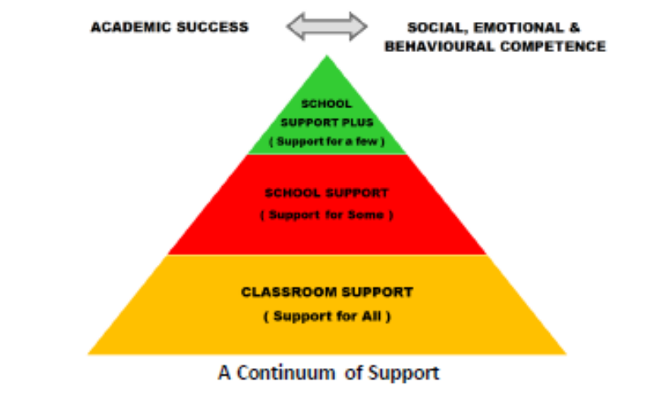
Continuum of Support

Slide 6

Continuum of Support- Level 1
(support for all)
Differentiating in the classroom – variety of strategies and modes of delivery.
Organisation support – Meitheal team Initiative
Whole school Reading Initiative – Ms Madden will elaborate on this.
Lunchtime Clubs – Board games, Art

Slide 7

Continuum of Support – Level 2 (support for some)
Common diagnoses – SLD (Dyslexia, Dyscalculia), DCD (Dyspraxia), Speech and Language delay, ASD
Students that are withdrawn from a subject and receive learning support (one to one or small group)

Slide 8
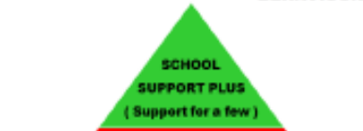
Continuum of Support – Level 3
(support for a few)
Students with complex needs – students are withdrawn for LS (small group and one to one)

Slide 9
Monitoring Progress in GCC
Students are monitored by reported exams 4 times a year.
These results are analysed by comparing them to their underlying ability and generates a CAT index. This CAT index tells us if the student is performing in line with their ability. Year Heads and LS Coordinators receive this information
Students are referred to the relevant SEN Year Coordinator by their subject teachers if they have any concerns and some in-house testing may then take place.
All students with Additional Needs are formally reviewed in April/May and targets are set for the following academic year. Students level of support can be increased, decreased or remain the same depending on progress.

Slide 10
Irish Exemptions
Irish Exemptions in GCC are granted based on criteria stated in Circular 0055/2022.
Applications for Irish exemptions are made to the school, however exemptions are granted based on the strict criteria in the aforementioned Circular. These criteria are not at the discretion of the school.

Slide 11
THANK YOU!

