Slide 1





Social Media Awareness

Slide 2

Our Working Group in the school…
Cormac Dooley
Caroline Byrne
Tom Pittam
Susan Casey
Fionán Clifford
Laura Nagle
Denise McCormack

Slide 3

Why do we need to tackle Social Media
Many of the issues reported in 1st to 3rd year between students involve social media interactions
Students are being targeted on social media platforms by fake accounts
Students are setting up fake accounts pretending to be other students
What’s happening online is making students anxious and afraid to come to school

Slide 4

What are we trying to achieve?
Promote a positive culture in GCC with regards social media use + reduce incidents with students involving social media
Target 2nd year students with a pilot workshop on Cyberbullying and Online harassment
Reduce students use of social media and use of their phone in general

Slide 5
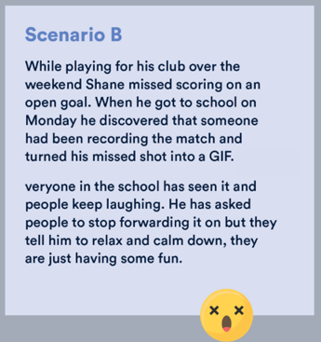
How are we going to do this?
1. Run workshop for all 2nd year base classes. Highlighting the dangers of cyberbullying and harassment. Going through scenarios (some which will be very familiar to students), and actions they can take if they encounter cyberbullying

Slide 6

How are we going to do this?
2. Put key messages about the dangers of social media and responsible use of apps on the notice boards of all the 2nd year classrooms. A student committee will be set up to run this

Slide 7
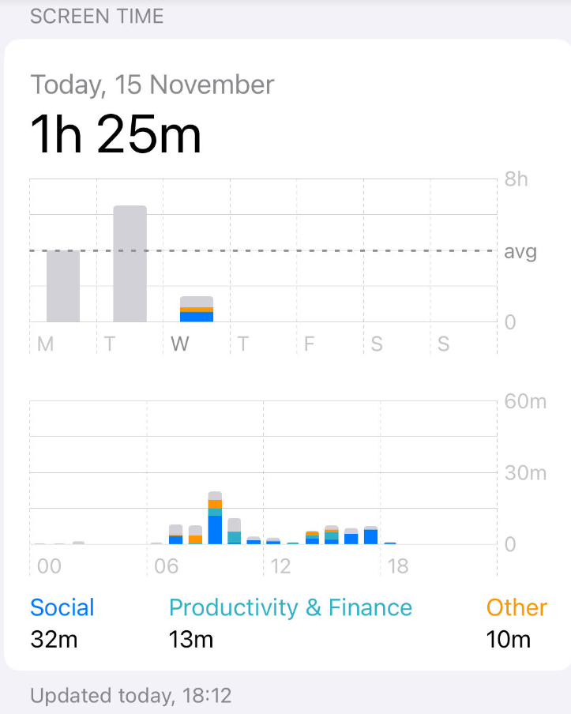
How are we going to do this?
3. Reduce screen time competition. Run for all 2nd year classes as a pilot. The winner of the competition will receive some sort of reward for their efforts.

Slide 8

How are we going to do this?
4. Visit to school from community guard. This will be done with different year groups where they will be addressed around the consequences of actions on social media

Slide 9

How are we going to do this?
5. Create an information leaflet with advice to parents that will be distributed via the school website. We will also present our initiative to the parents council to show we are encouraging safe use of social media by our students

Slide 10
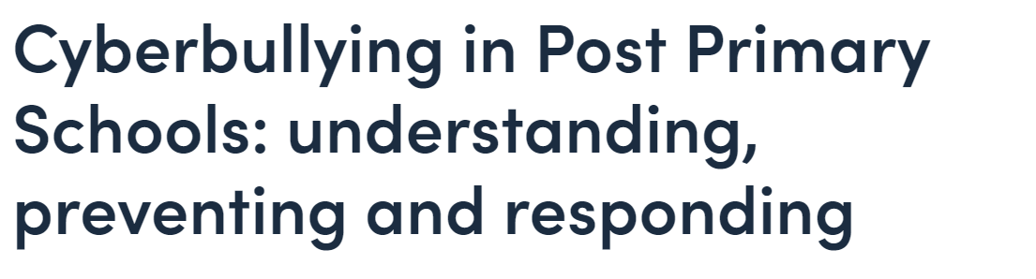
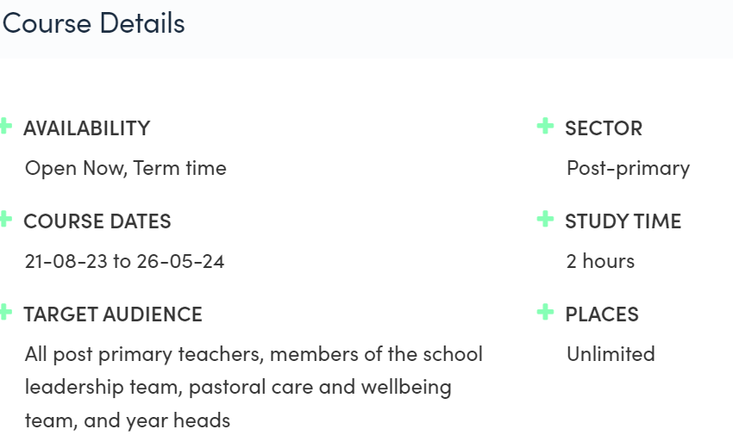
Some help for staff
https://www.oidetechnologyineducation.ie/onlinecourses/cyberbullying-in-post-primary-schools/

